Slide 1


Aleem Noorani
7DEC21

Slide 2

Outline
Executive Summary
Introduction
Methodology
Results
Conclusion
Appendix

Slide 3
Executive Summary
Summary of methodologies
Summary of all results

Slide 4
Introduction
Project background and context
Problems you want to find answers

Slide 5


Slide 6
Methodology
Executive Summary
Data collection methodology:
SpaceX Rest API
Wikipedia Web Scrapping
Perform data wrangling
Processed with Python code
Perform exploratory data analysis (EDA) using visualization and SQL
Perform interactive visual analytics using Folium and Plotly Dash
Perform predictive analysis using classification models
How to build, tune, evaluate classification models

Slide 7
Data Collection
Data from SpaceX Rest API.
Data published directly from SpaceX
Webscrapping of Wikipedia
Used as data to test SpaceX data against

Slide 8
Data Collection – SpaceX API
SpaceX API Response
SpaceX API data was converted into useable filetype .csv
GitHub URL of Files
Converted Response Data into a .json file
Applied functions to clean data into useable format
Assigned list to dictionary, to then create pd dataframe
Filter dataframe, and export as .csv

Slide 9
Data Collection - Scraping
Response from Wikipedia HTML
BeautifulSoup used to collect data from Wikipedia
Github URL of File
Turn HTML data into BeautifulSoup Object
Create Dictionary of data
Append data to dictionary keys
Convert dictionary into dataframe, then export .csv

Slide 10
Data Wrangling
Data Wrangling was simple process
Perform EDA on datasets
Calculate the number of launch sites
Calculate the number of orbits
Calculate Mission outcomes
Analyze success rate for landings
Export to .csv

Slide 11
EDA with Data Visualization
We created multiple charts
Flight vs Mass, Flight vs Launch Site, Mass vs Launch Site, Flight vs Orbit, Mass vs Orbit, Payload vs Flight, Payload vs Orbit
We created SQL queries
Identify unique launch sites, average payload mass, total launches by NASA, names of boosters who succeeded, annualized success metrics
We also created an interactive data map using Folium
Check out the Github link to utilize the maps
GITHUB URL of Python EDA
GITHUB URL of SQL EDA
GITHUB URL of Folium EDA

Slide 12
Build a Dashboard with Plotly Dash
We also create a Dashboard with Plotly Dash
The interactions allow for anyone to see the relationship between range, payload mass, and launch sites.
Easy to use and see for people who aren’t used to data analysis
GITHUB URL of Plotly Dash

Slide 13
Predictive Analysis (Classification)
We utilized Machine Learning predictive analysis to identify best outcomes and models to see whether a launch will be successful or not
Models used
NumPy Array
GridSearchCV
GITHUB URL of Plotly Dash

Slide 14


Slide 15
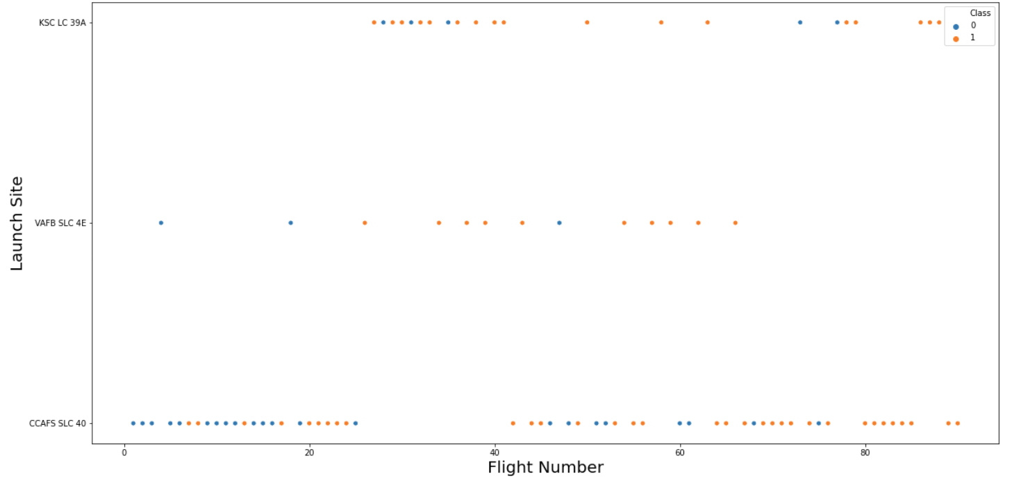
Flight Number vs. Launch Site

Slide 16
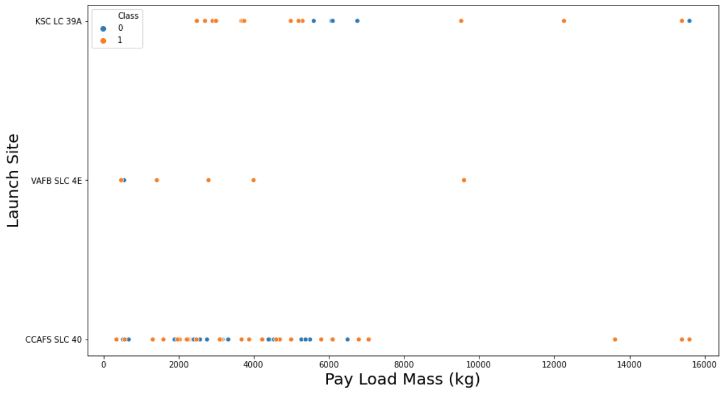
Payload vs. Launch Site

Slide 17
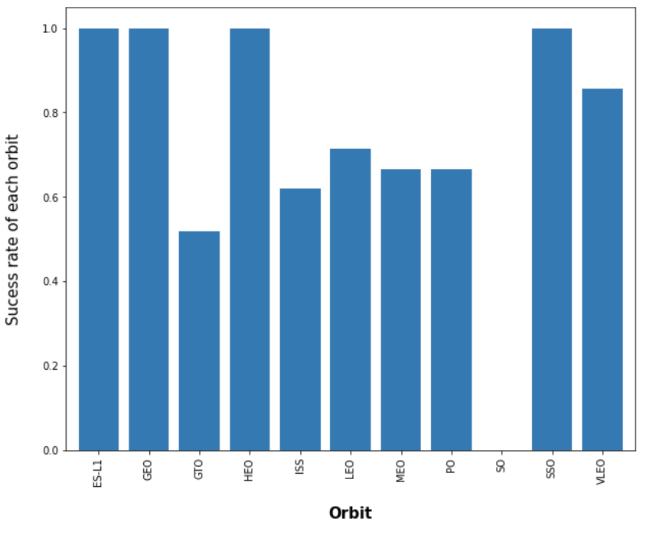
Success Rate vs. Orbit Type

Slide 18
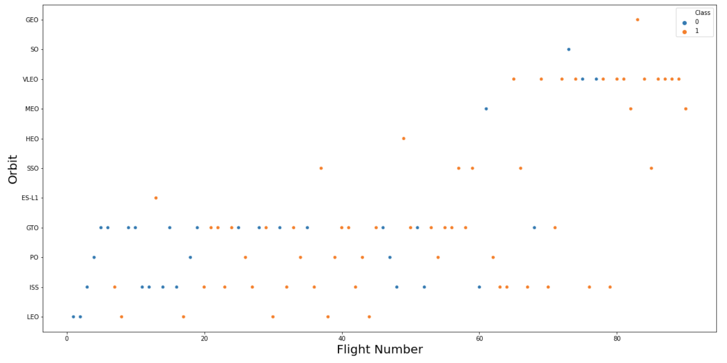
Flight Number vs. Orbit Type

Slide 19
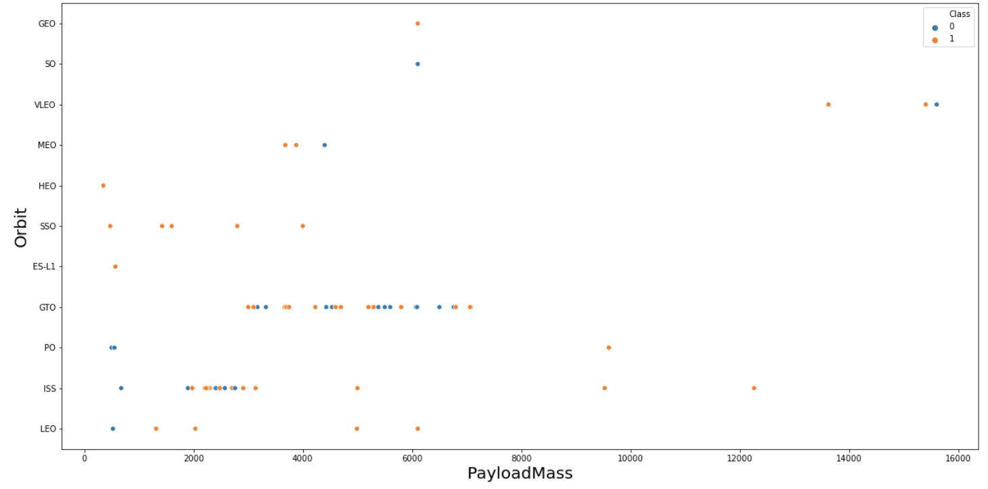
Payload vs. Orbit Type

Slide 20
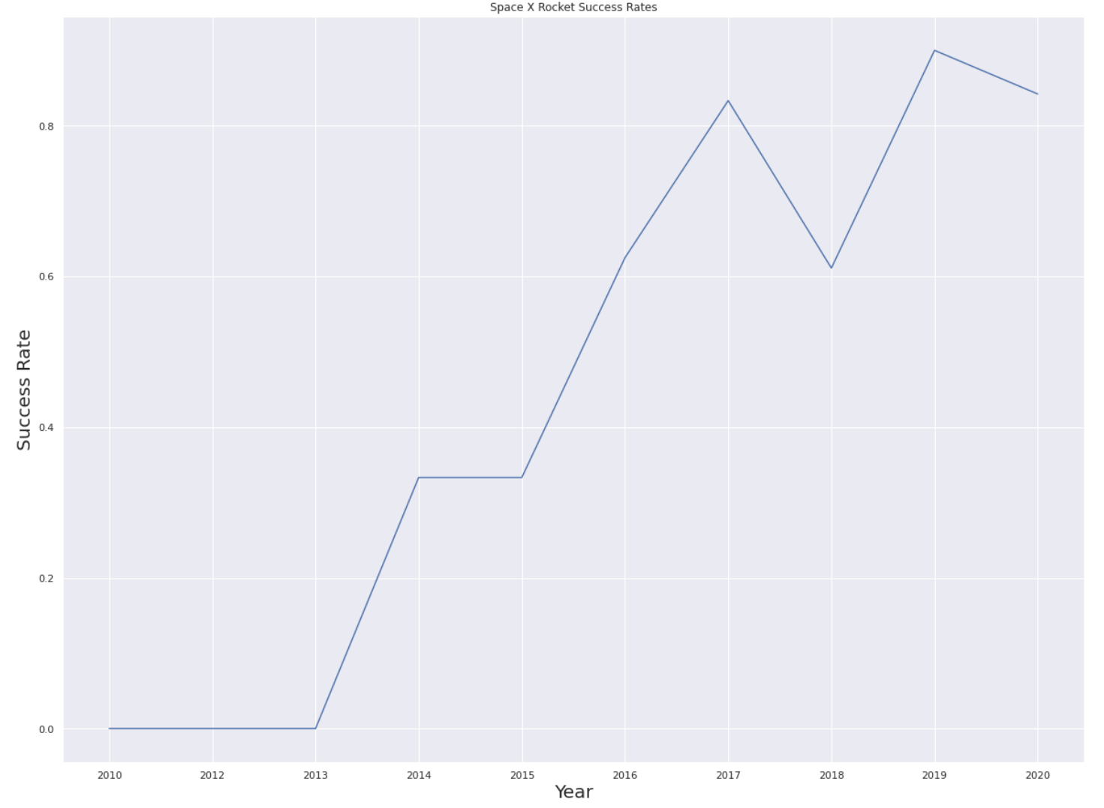
Launch Success Yearly Trend

Slide 21
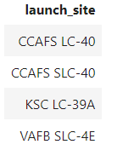
All Launch Site Names
Names of the unique launch sites

Slide 22
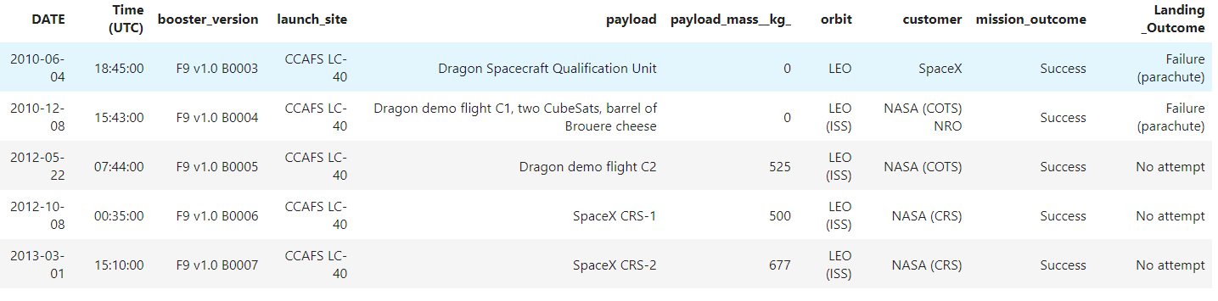
Launch Site Names Begin with 'CCA'
Find 5 records where launch sites begin with `CCA`

Slide 23
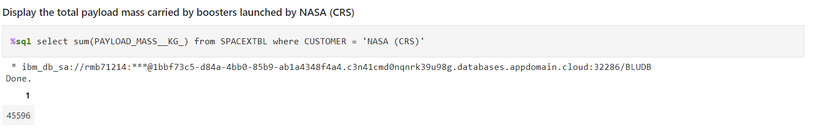
Total Payload Mass
Calculate the total payload carried by boosters from NASA

Slide 24
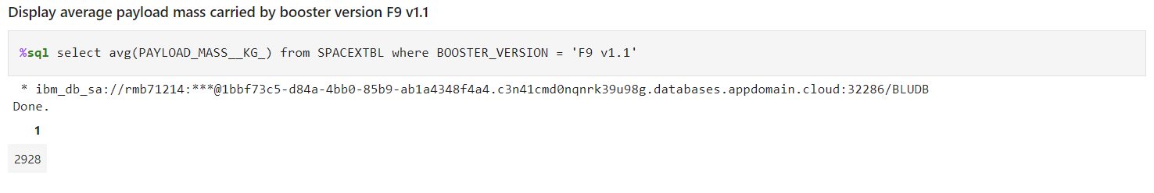
Average Payload Mass by F9 v1.1
Calculate the average payload mass carried by booster version F9 v1.1

Slide 25
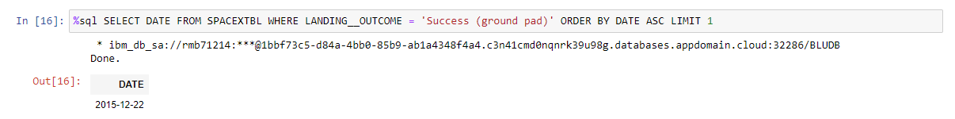
First Successful Ground Landing Date
Find the dates of the first successful landing outcome on ground pad

Slide 26
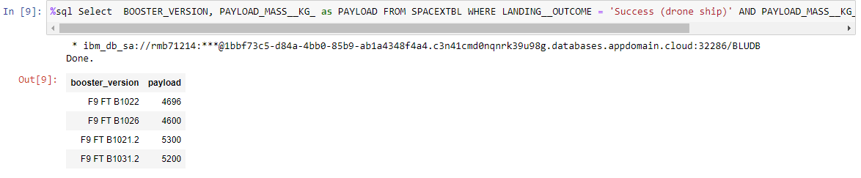
Successful Drone Ship Landing with Payload between 4000 and 6000
List the names of boosters which have successfully landed on drone ship and had payload mass greater than 4000 but less than 6000

Slide 27
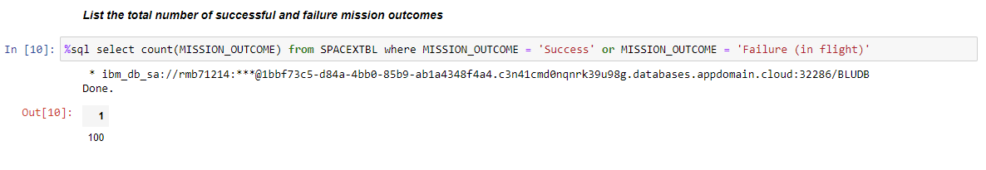
Total Number of Successful and Failure Mission Outcomes
Calculate the total number of successful and failure mission outcomes

Slide 28
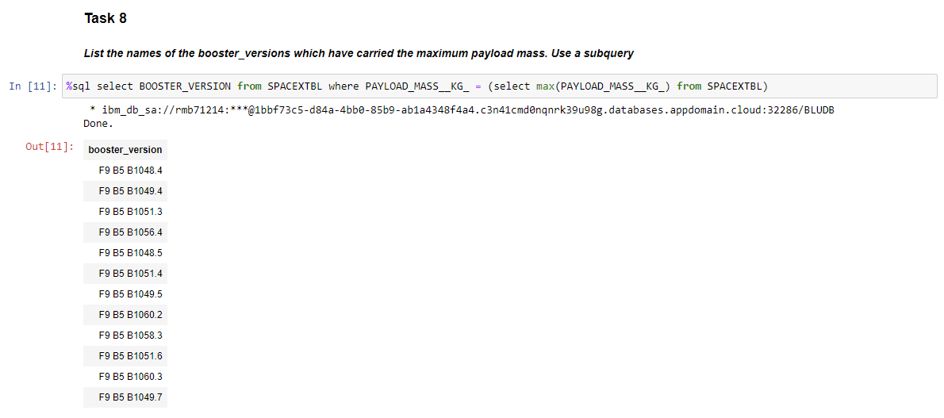
Boosters Carried Maximum Payload
List the names of the booster which have carried the maximum payload mass

Slide 29
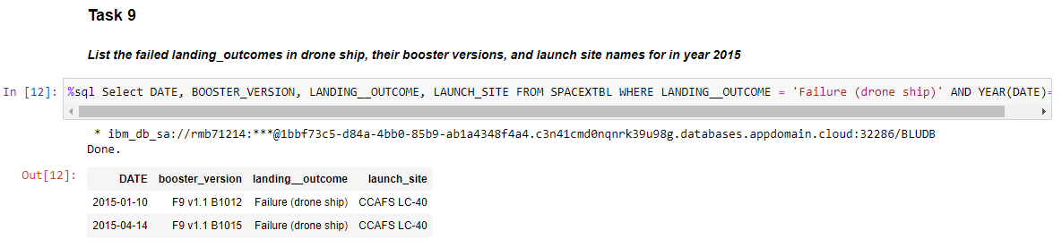
2015 Launch Records
List the failed landing_outcomes in drone ship, their booster versions, and launch site names for in year 2015

Slide 30
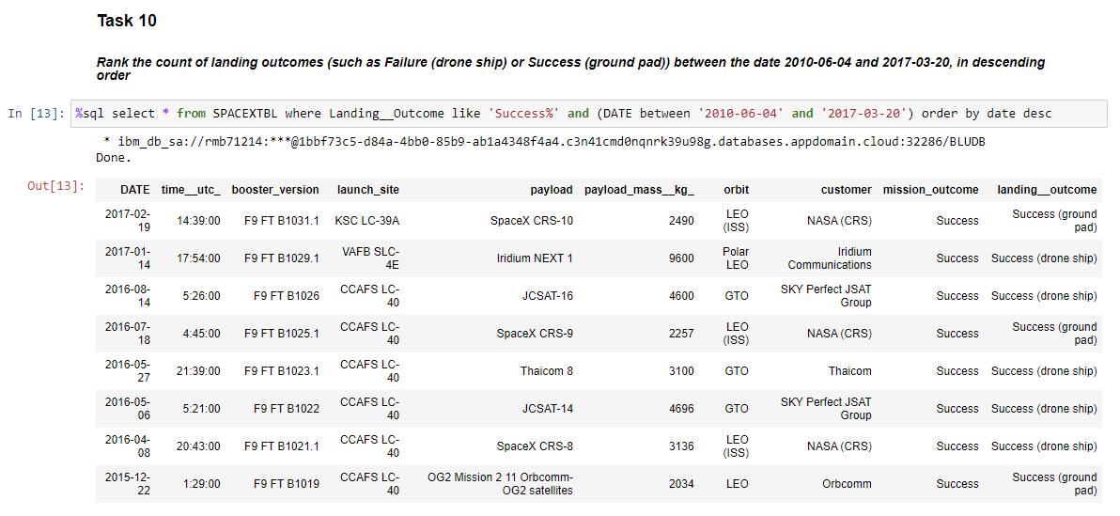
Rank Landing Outcomes Between 2010-06-04 and 2017-03-20
Rank the count of landing outcomes (such as Failure (drone ship) or Success (ground pad)) between the date 2010-06-04 and 2017-03-20, in descending order

Slide 31


Slide 32
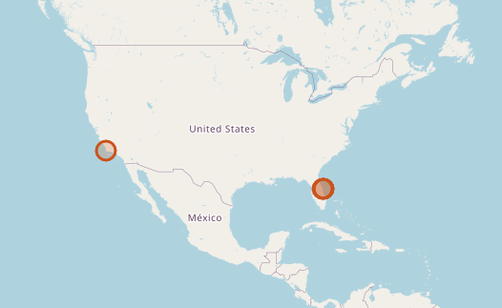
CONUS Launch Site Locations

Slide 33
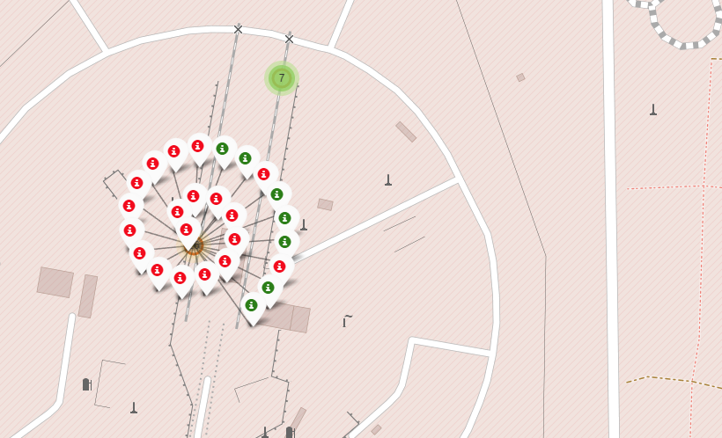
CCAFS Launch Outcomes

Slide 34
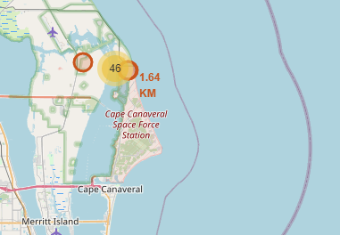
CCAFS launch site distance to coast

Slide 35


Slide 36
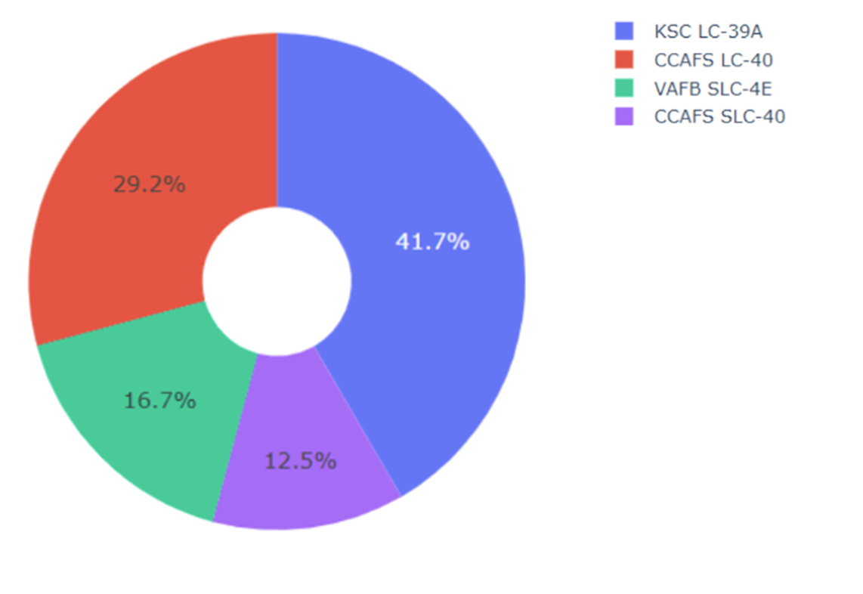
Launches By Sites

Slide 37
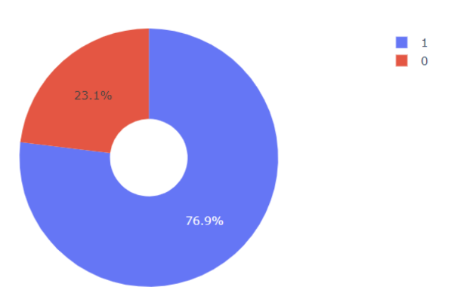
Most Successful Launch Site (KSC LC-39A)

Slide 38
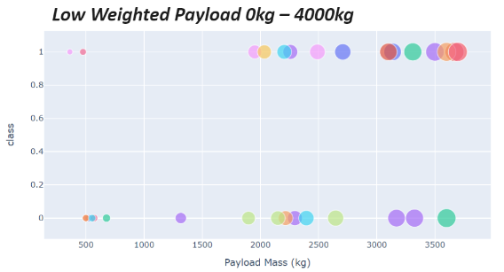
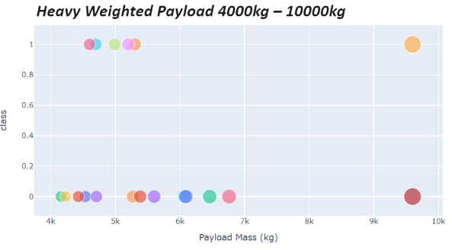
Payload Success Rates based on Weight

Slide 39


Slide 40
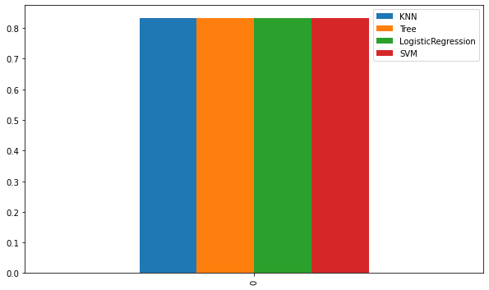
Classification Accuracy
Best Algorithm is Tree, but barely
They are all so close that it doesn’t really matter

Slide 41
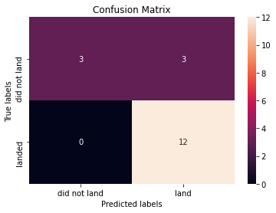
Confusion Matrix
Confusion matrix showing the Tree which allows us to distinguish between type 1 and type 2 errors

Slide 42
Conclusions
Tree was the best algorithm for prediction
Low weight is better than heavy weight payload
Launches are getting more successful with time
GEO, HEO, SSO, and ES-L1 are the best orbits
CCAFS is the best launch site

Slide 43


